Slide 1
A Framework for Generalizable Classification Under Label Shift
Ives Xue
Mentor: Prof. Ciaran Evans

Slide 2
Background
Classification learns a rule to predict labels from features.
Standard methods assume source and target data come from the same distribution.
In reality, future data often change across time or populations. This is called dataset shift.
Dataset shift matters because it can reduce both accuracy and probability calibration.
Calibration refers to how well predicted probabilities agree with actual outcome frequencies.

Slide 3
Data Set Shift
Need: Assumptions about how distribution changes
Data: X (features); Y (labels)；P (Source); Q (Target)
Covariate Shift Assumption:
Label Shift Assumption:
Distribution of source data
Distribution of target data
Notes:
When Data shift occurs, what can we do with it? We need some assumptions. There are some existing assumptions about that.

Slide 4
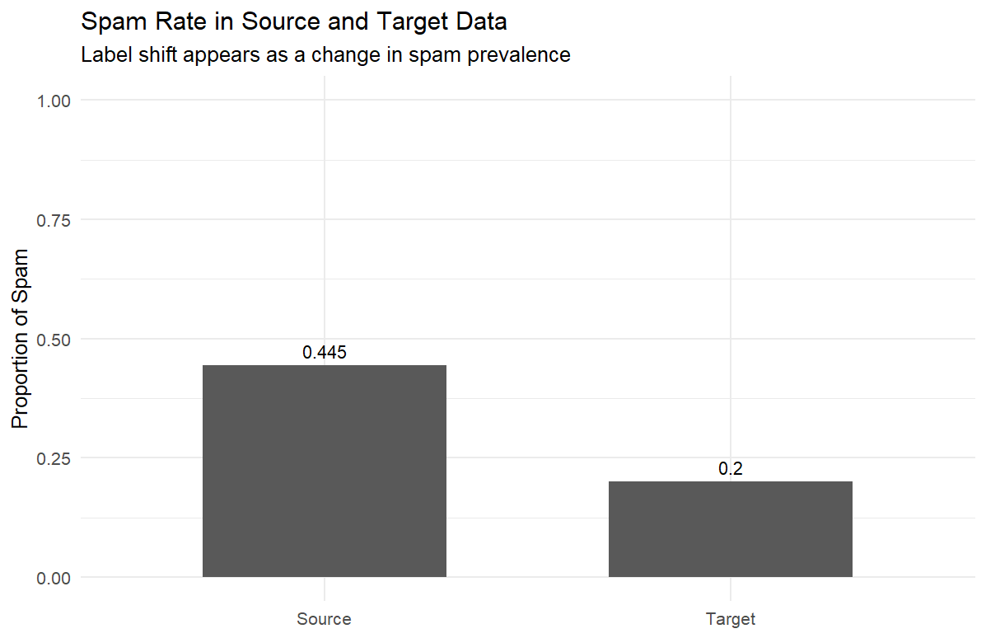
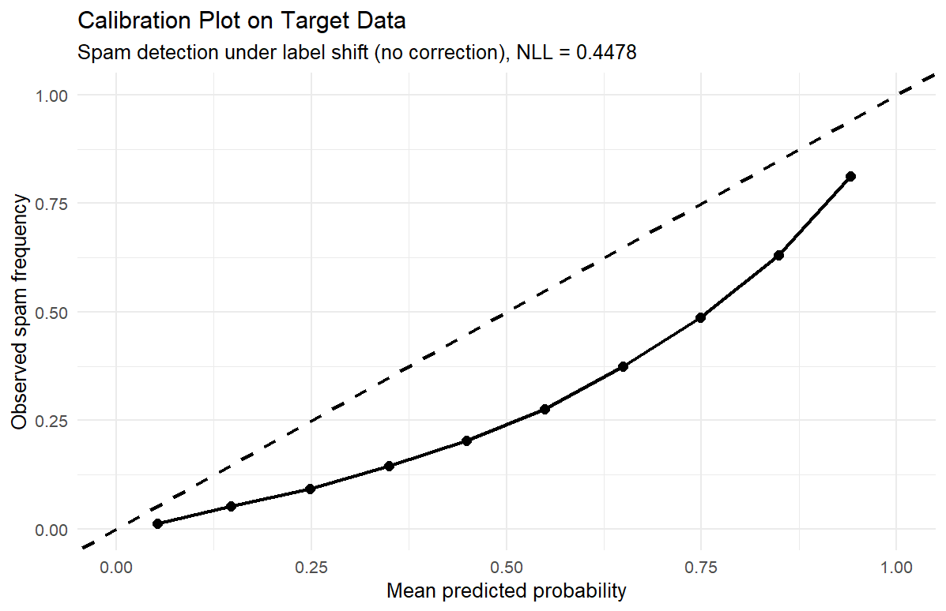
Label Shift
Our Goal: Creating generalizable classification model by selecting stable features that remain reliable under label shift.
Why Label Shift: 1. Current works on data shift mostly focus on covariate shift, but few on label shift.
2. We have a lot of real-world settings where label shift assumption can be applied to.
Eg. Spam detection: patterns of words are similar, but spam rate is different.
Data Simulation:
Notes:
Works had done for covariate shift. Simulated example, imagine we simulated a data. Talk more about what does the calibration plot mean here. On points

Slide 5
Estimate Label Shift
However, in practice, we can not observe labels in target data.
Can we estimate q(y)? Here are existing literatures:
Black Box Shift Estimator ¹
uses confusion matrix + target prediction frequencies.
Maximum Likelihood Label Shift ²
uses likelihood-based estimation with EM algorithm.
Then we can correct label shift
1: Lipton, Zachary C., Yu-Xiang Wang, and Alex Smola. 2018. “Detecting and Correcting for Label Shift with Black Box Predictors.” arXiv [Cs.LG]. arXiv. http://arxiv.org/abs/1802.03916.
2: Garg, Saurabh, Yifan Wu, Sivaraman Balakrishnan, and Zachary C. Lipton. 2020. “A Unified View of Label Shift Estimation.” arXiv [Cs.LG]. arXiv. http://arxiv.org/abs/2003.07554.
Notes:
citations and footnote here. Make clear method in the literature.

Slide 6
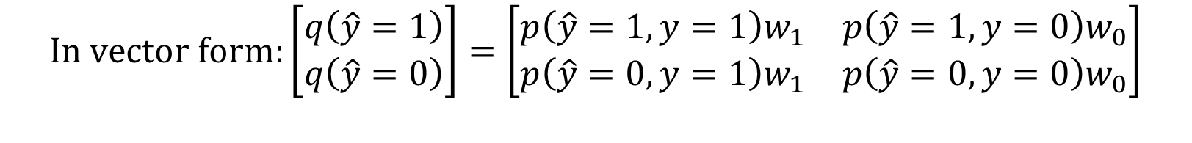
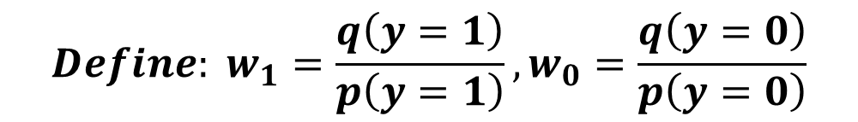
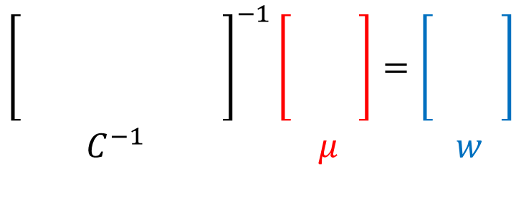
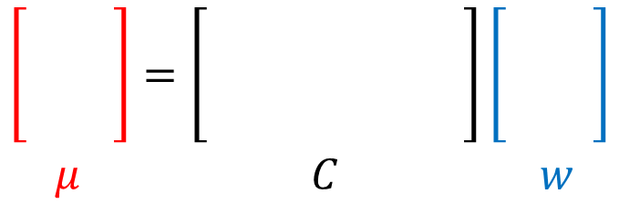
Black Box Shift Estimation (BBSE)
$$Define: w_{1}=\frac{q\left(y=1\right)}{p\left(y=1\right)},w_{0}=\frac{q\left(y=0\right)}{p\left(y=0\right)}$$
$$In vector form:\left[\begin{matrix}\begin{aligned}q\left(\hat{y}=1\right) \\ q\left(\hat{y}=0\right)\end{aligned}\end{matrix}\right]=\left[\begin{matrix}p\left(\hat{y}=1,y=1\right)w_{1} & p\left(\hat{y}=1,y=0\right)w_{0} \\ p\left(\hat{y}=0,y=1\right)w_{1} & p\left(\hat{y}=0,y=0\right)w_{0}\end{matrix}\right]$$
$$\left[\begin{matrix}\begin{aligned}1 \\ 1 \\ 1\end{aligned}\end{matrix}\right]=\left[\begin{aligned}1 \\ 1 \\ 1 \end{aligned}\right]\left[\begin{matrix}\begin{aligned}1 \\ 1 \\ 1 \end{aligned}\end{matrix}\right]$$
$$μ C w$$
$${\left[\begin{aligned}1 \\ 1 \\ 1 \end{aligned}\right]}^{−1}\left[\begin{matrix}\begin{aligned}1 \\ 1 \\ 1\end{aligned}\end{matrix}\right]=\left[\begin{matrix}\begin{aligned}1 \\ 1 \\ 1 \end{aligned}\end{matrix}\right]$$
$${ C}^{−1} μ w$$
Notes:
Add w definitions and skip the proof of math here.

Slide 7
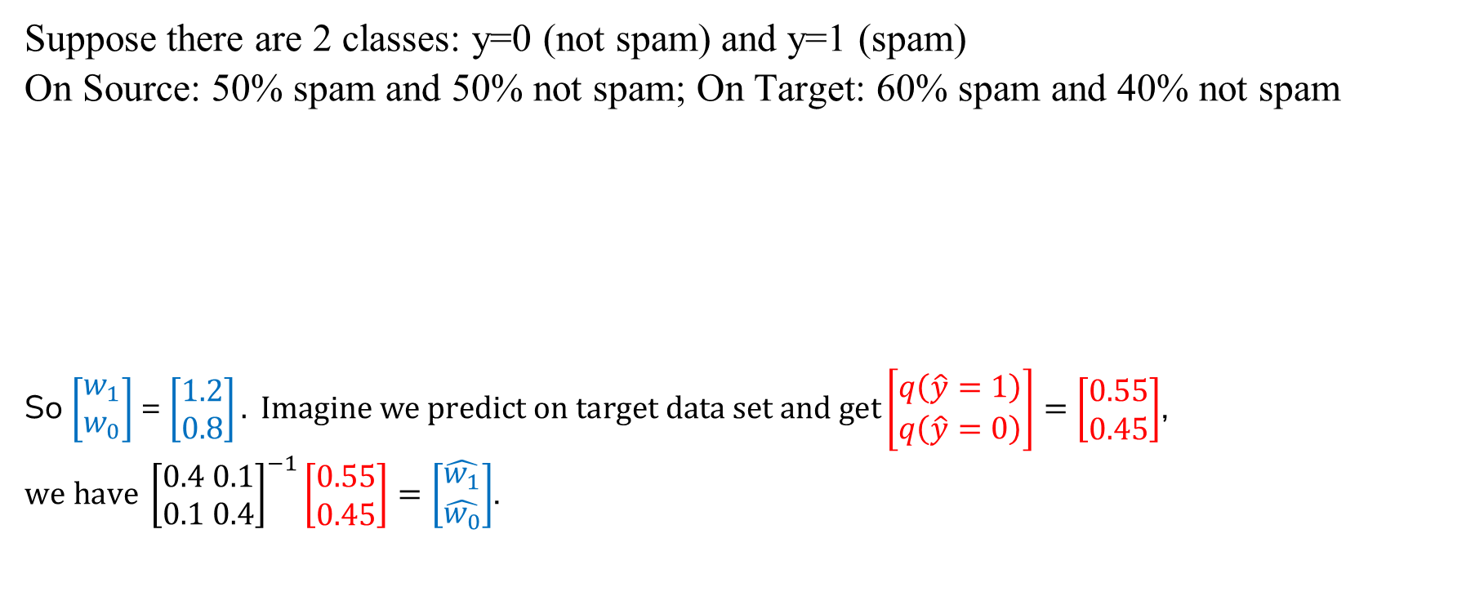

BBSE Example
$$w_{1}=\frac{q\left(y=1\right)}{p\left(y=1\right)},w_{0}=\frac{q\left(y=0\right)}{p\left(y=0\right)}$$
Suppose there are 2 classes: y=0 (not spam) and y=1 (spam)
On Source: 50% spam and 50% not spam; On Target: 60% spam and 40% not spam
So $\left[\begin{aligned}w_{1} \\ w_{0}\end{aligned}\right]$ = $\left[\begin{aligned}1.2 \\ 0.8\end{aligned}\right]. Imagine we predict on target data set and get\left[\begin{matrix}\begin{aligned}q\left(\hat{y}=1\right) \\ q\left(\hat{y}=0\right)\end{aligned}\end{matrix}\right]=\left[\begin{aligned}0.55 \\ 0.45\end{aligned}\right]$, $we have {\left[\begin{aligned}0.4 0.1 \\ 0.1 0.4\end{aligned}\right]}^{−1}\left[\begin{aligned}0.55 \\ 0.45\end{aligned}\right]=\left[\begin{aligned}\hat{w_{1}} \\ \hat{w_{0}}\end{aligned}\right]$.
True Label | True y = 1 | True y = 0 | Total
Predicted y = 1 | 40 | 10 | 50
Predicted y = 0 | 10 | 40 | 50
Total | 50 | 50 | 100
$\frac{\left[\begin{aligned}0.4 −0.1 \\ −0.1 0.4\end{aligned}\right]}{0.4×0.4 − 0.1×0.1} \left[\begin{aligned}0.55 \\ 0.45\end{aligned}\right]$ $=$ $\frac{\left[\begin{aligned}0.4 −0.1 \\ −0.1 0.4\end{aligned}\right]}{0.15} \left[\begin{aligned}0.55 \\ 0.45\end{aligned}\right]=\frac{1}{0.15} \left[\begin{aligned}0.175 \\ 0.125\end{aligned}\right]=\left[\begin{matrix}\begin{aligned}1.16 \\ 0. 83\end{aligned}\end{matrix}\right]≈\left[\begin{aligned}1.2 \\ 0.8\end{aligned}\right]$
What if the matrix NOT invertible?
Notes:
Talk about the weights, also the order of the functions

Slide 8
Maximum Likelihood Label Shift (MLLS)
MLLS approaches this problem from a likelihood perspective: it looks for weights that make the reweighted source model fit the unlabeled target data well.
This leads to an optimization problem, rather than a linear system like BBSE.
The target labels are not observed, so the optimization is naturally an incomplete-data problem.
Therefore, a natural tool for this setting is the EM algorithm¹, which is designed for maximum likelihood estimation with missing or latent variables.
1. Garg, Saurabh, Yifan Wu, Sivaraman Balakrishnan, and Zachary C. Lipton. 2020. “A Unified View of Label Shift Estimation.” arXiv [Cs.LG]. arXiv. http://arxiv.org/abs/2003.07554.
Saerens, Marco, Patrice Latinne, and Christine Decaestecker. 2002. “Adjusting the Outputs of a Classifier to New a Priori Probabilities: A Simple Procedure.” Neural Computation 14 (1): 21–41.
Dempster, A. P., N. M. Laird, and D. B. Rubin. 1977. “Maximum Likelihood from Incomplete Data via the EM Algorithm.” Journal of the Royal Statistical Society 39 (1): 1–38.
Notes:
2 more foot notes: Orinigal EM paper in MLLS case; General EM algorithm paper.

Slide 9
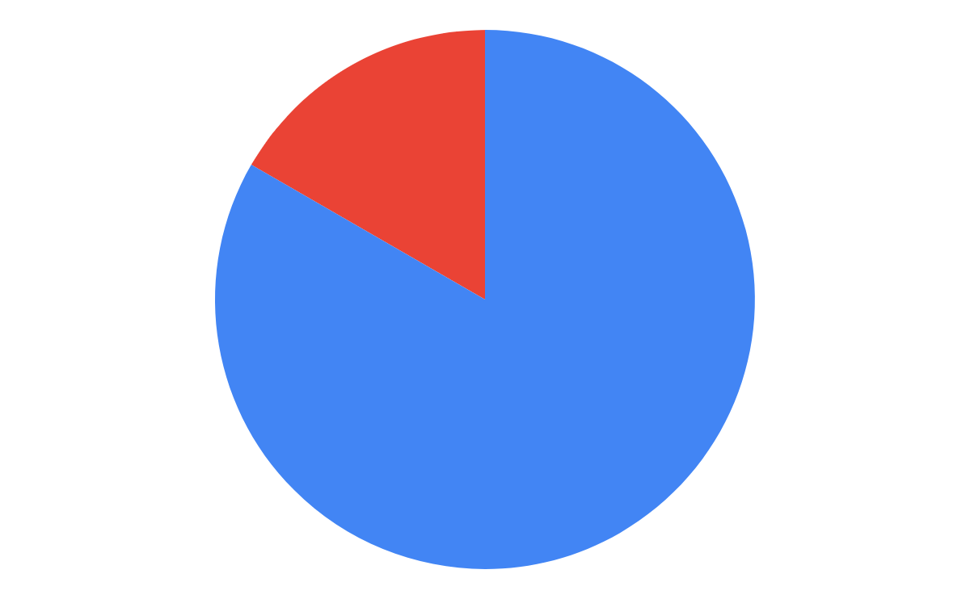
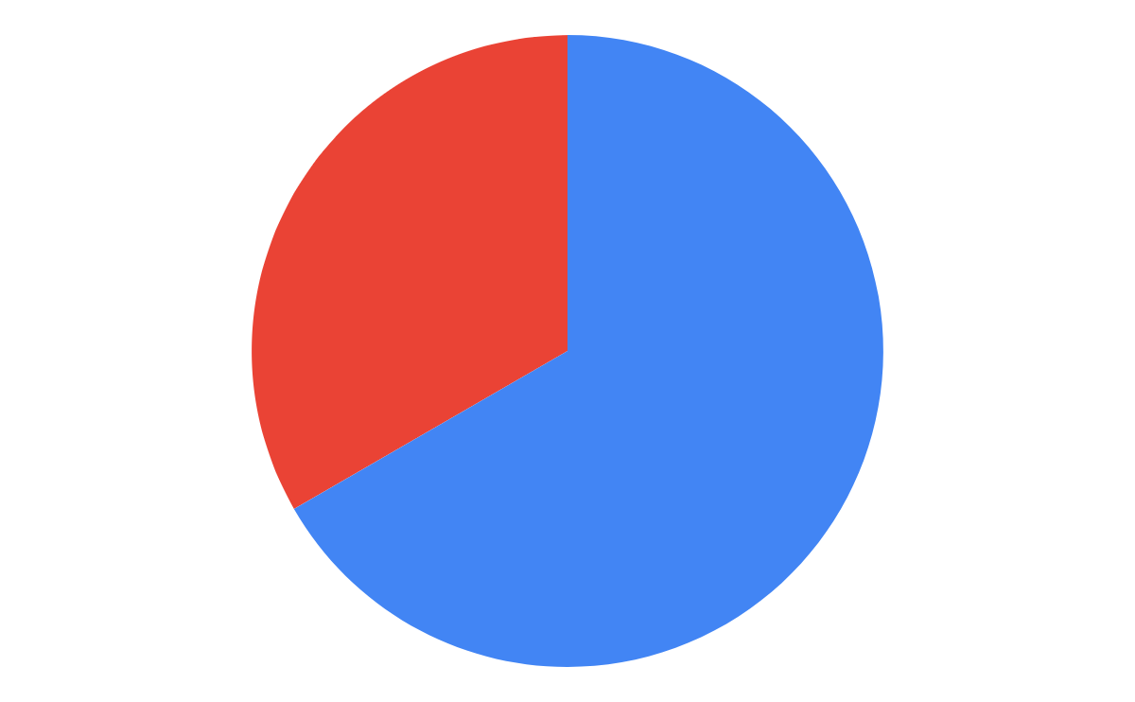
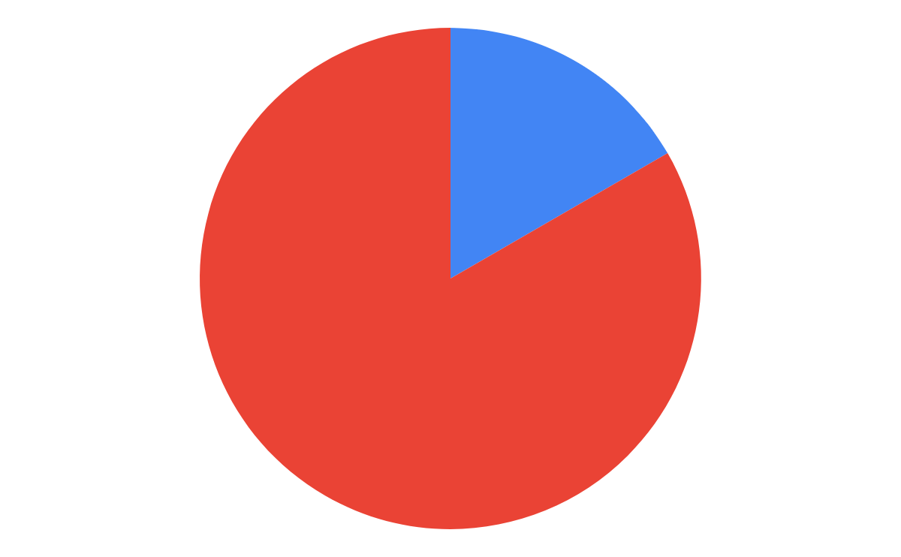
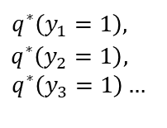
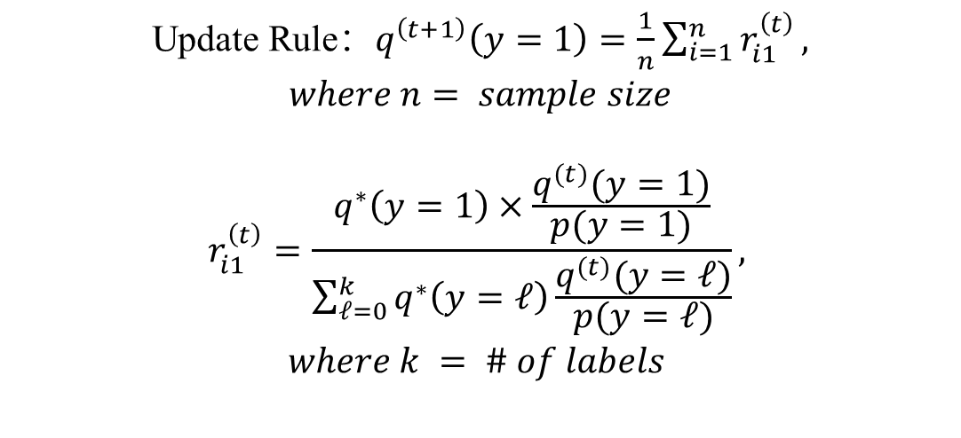


EM Algorithm
Source
Target
Initialize：$q^{0}(y=1)= p(y=1)$
$$q^{∗}\left(y_{1}=1\right),$$
$$q^{∗}\left(y_{2}=1\right),$$
$$q^{∗}\left(y_{3}=1\right)…$$
Classifier
Update：$q^{\left(t+1\right)}\left(y=1\right)=\frac{1}{n}\sum_{i=1}^{n}{r_{i1}^{\left(t\right)}}$
Update Rule：$q^{\left(t+1\right)}\left(y=1\right)=\frac{1}{n}\sum_{i=1}^{n}{r_{i1}^{\left(t\right)}},$
$$where n= sample size$$
$$r_{i1}^{\left(t\right)}=\frac{q^{∗}\left(y=1\right)×\frac{q^{(t)}(y=1)}{p(y=1)}}{\sum_{ℓ=0}^{k}{q^{∗}\left(y=ℓ\right)}\frac{q^{(t)}(y=ℓ)}{p(y=ℓ)}},$$
$$where k = \# of labels$$
$$⋮$$
Repeat Until Convergence:
Notes:
Order of animation

Slide 10
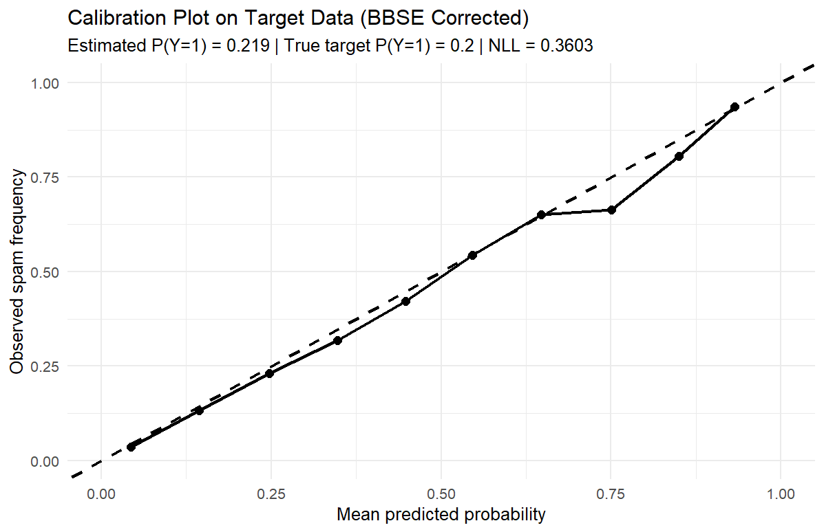
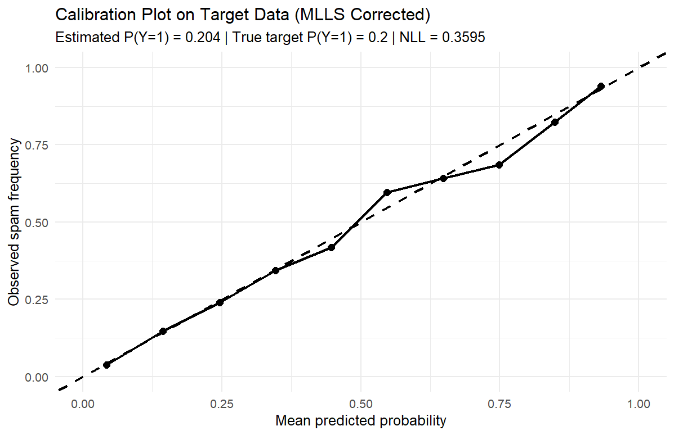
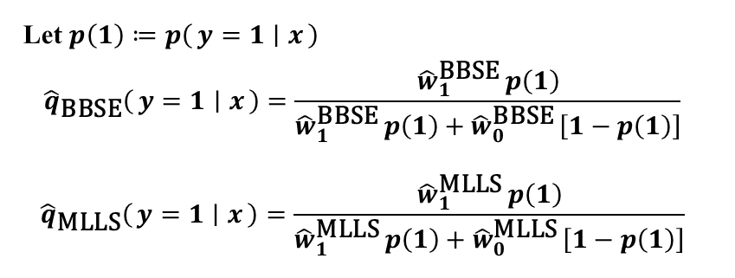
Calibration
Let $p\left(1\right)≔p\left(y=1 ∣ x\right)$
$${\hat{q}}_{\text{BBSE}}\left(y=1 ∣ x\right)=\frac{{\hat{w}}_{1}^{\text{BBSE}} p\left(1\right)}{{\hat{w}}_{1}^{\text{BBSE}} p\left(1\right)+{\hat{w}}_{0}^{\text{BBSE}} \left[1−p\left(1\right)\right]}$$
$${\hat{q}}_{\text{MLLS}}\left(y=1 ∣ x\right)=\frac{{\hat{w}}_{1}^{\text{MLLS}} p\left(1\right)}{{\hat{w}}_{1}^{\text{MLLS}} p\left(1\right)+{\hat{w}}_{0}^{\text{MLLS}} \left[1−p\left(1\right)\right]}$$
Notes:
But the correction equation on the left top, saying by bayes.

Slide 11

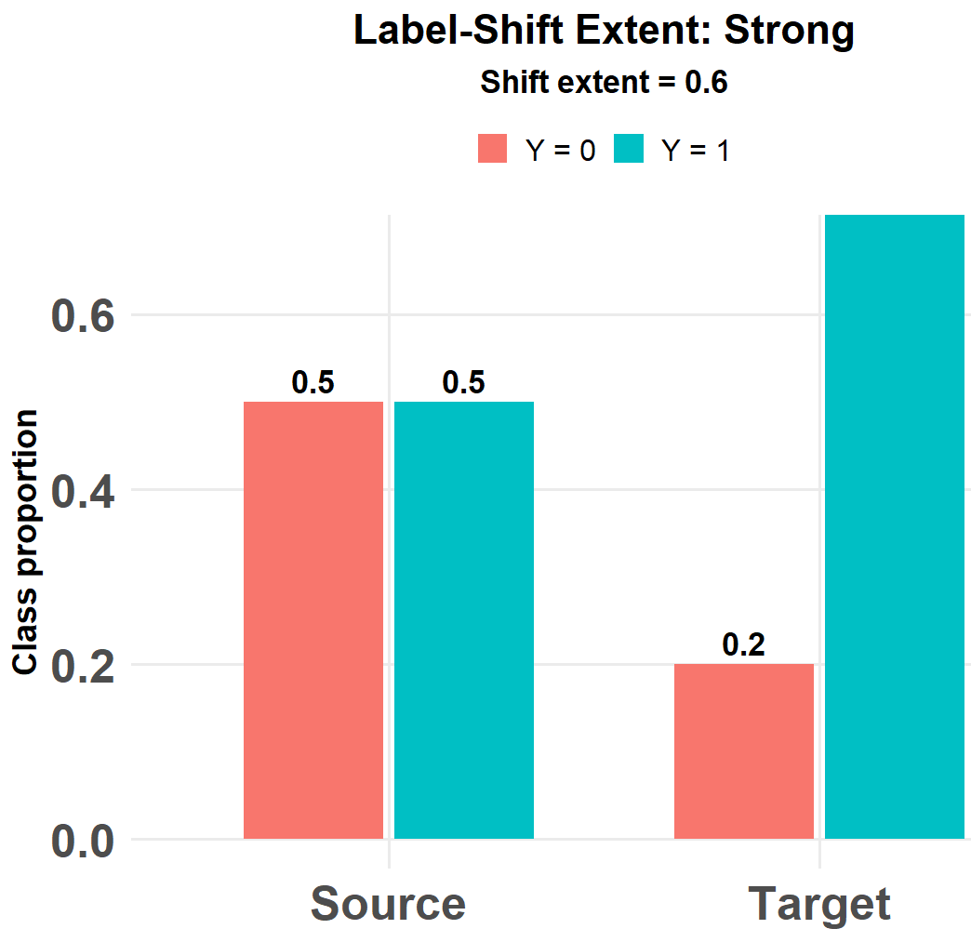
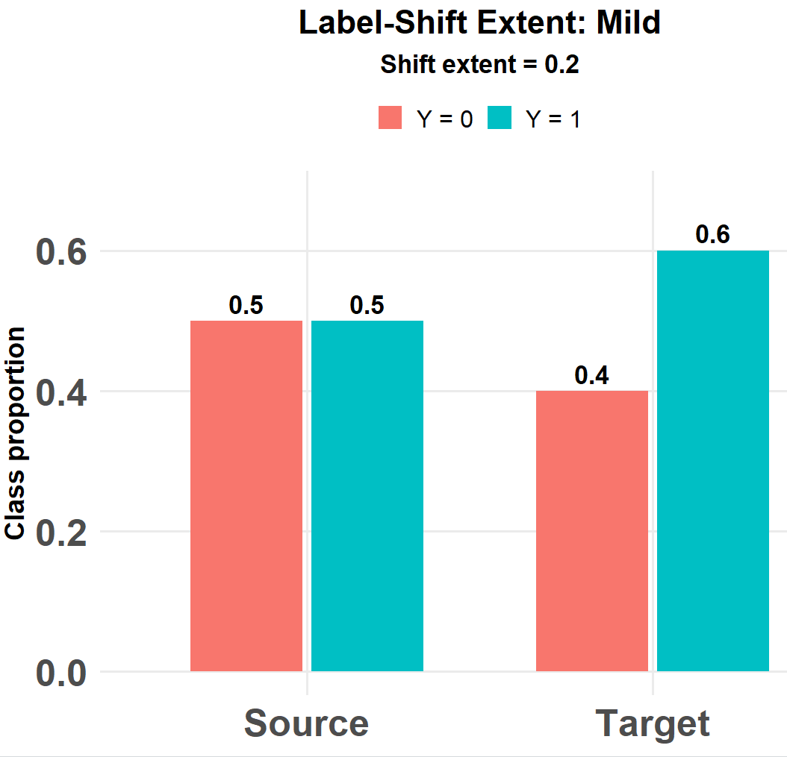
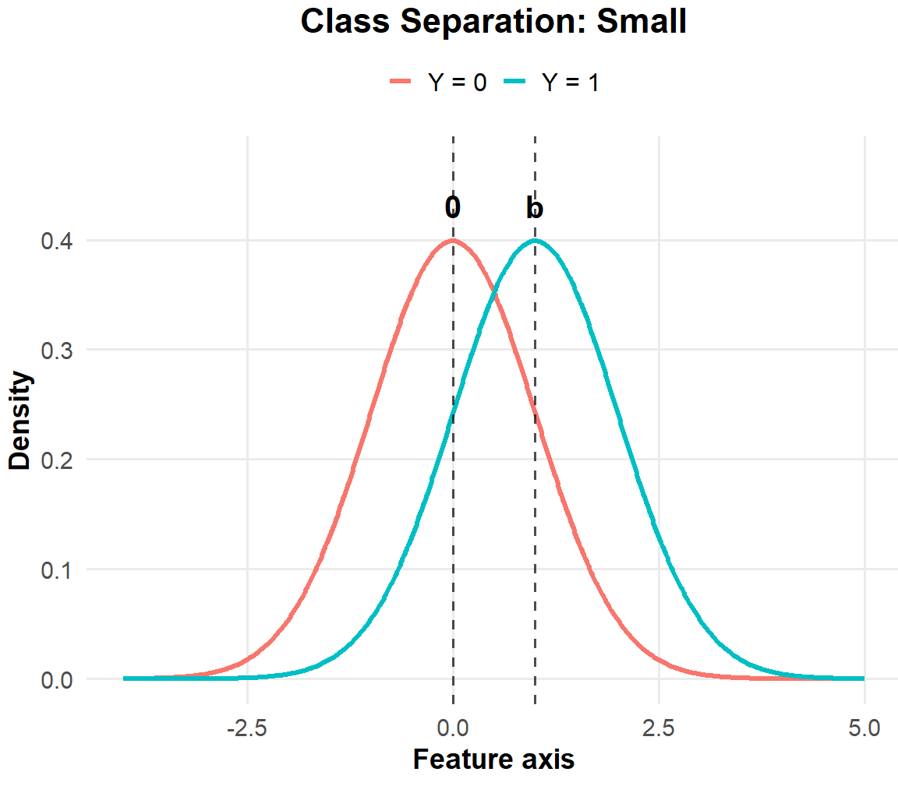
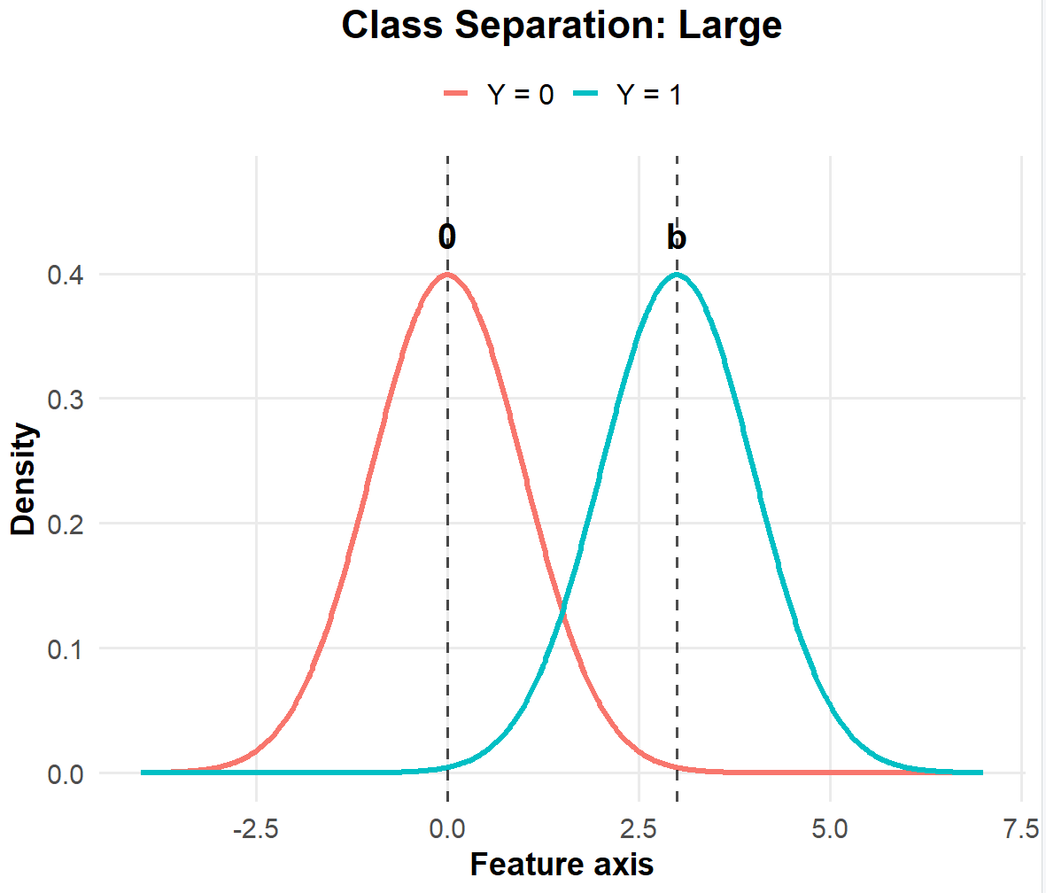
Comparison between BBSE and MLLS
We compare BBSE and MLLS in binary cases for different:
class separation, (2) label-shift extent, (3) sample size
Class Separation: Distance between conditional distribution p(x|y).
Label Shift Extent: Difference between p(y) and q(y).
Notes:
Labels are small, and consistent with source and target

Slide 12
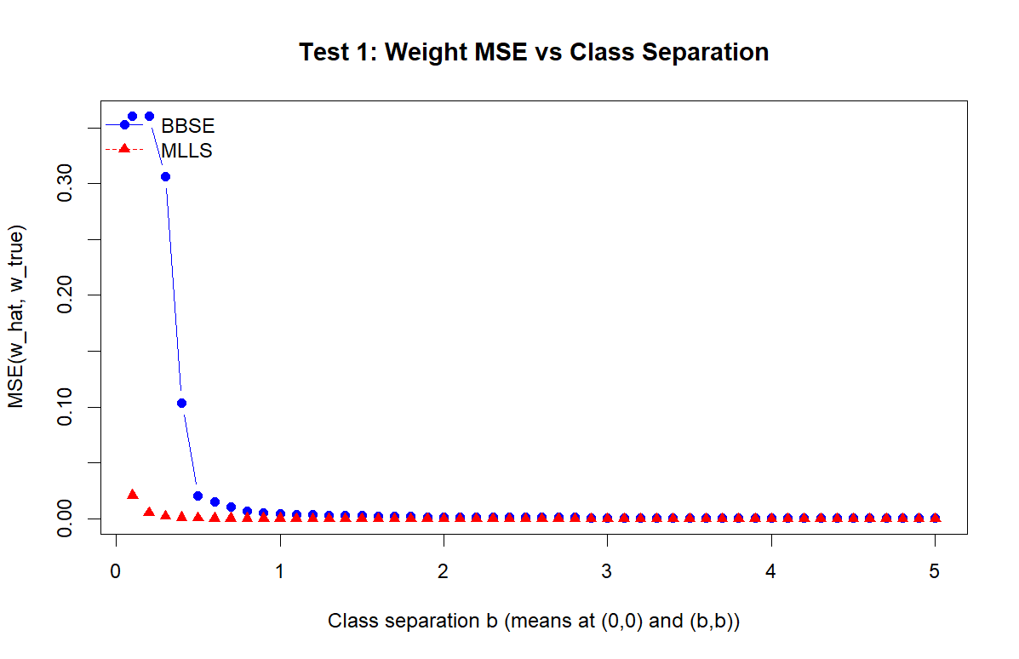
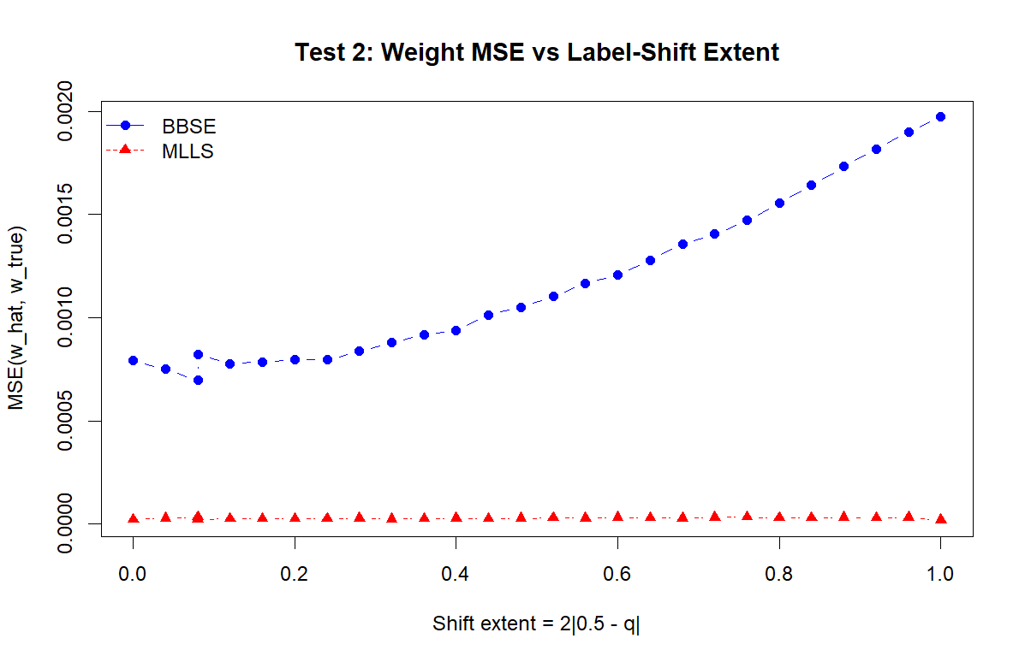
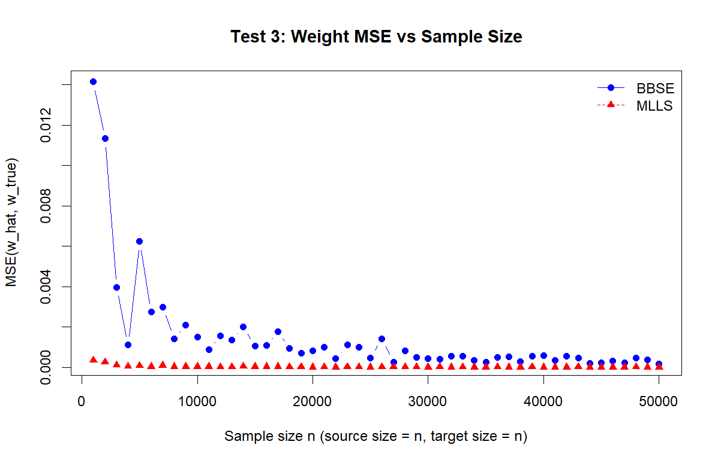
Comparison between BBSE and MLLS
Performance metric: weight estimation error, measured by MSE between estimated weight and true weight. Lower is better.

Slide 13
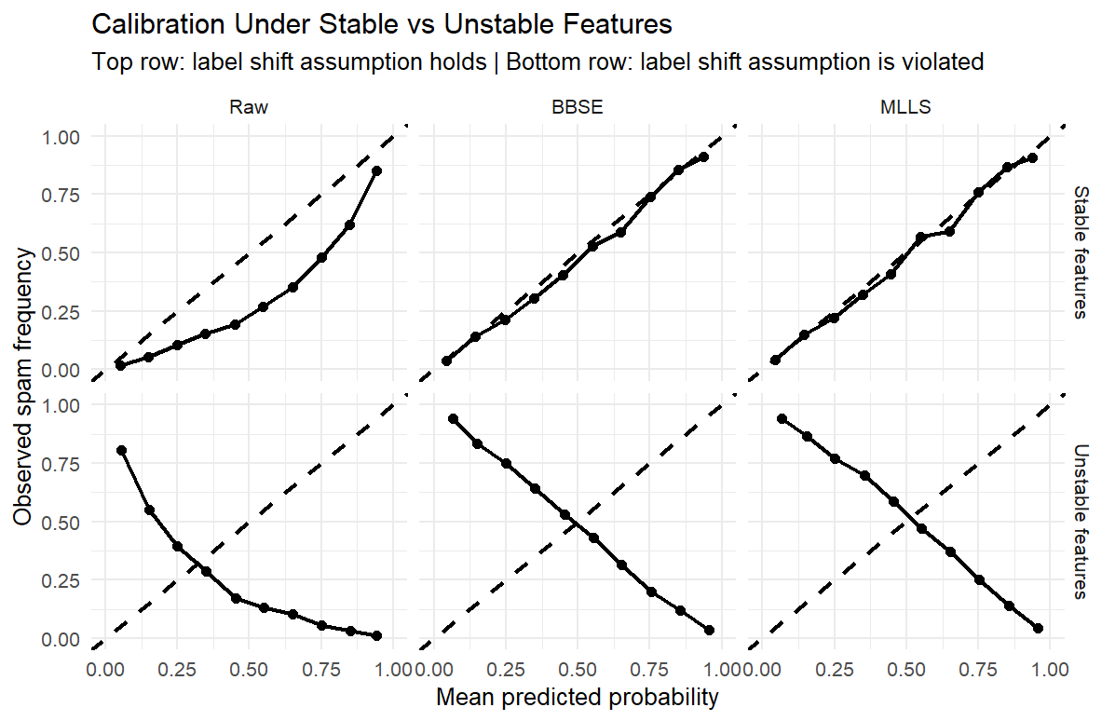
Stable & Unstable Variables
So far we only have features satisfying label shift, what if not?
Stable Features: Features satisfy label shift assumption
Unstable Features: Features do not satisfy label shift assumption
Notes:
Introduce wassertein distance, heat maps and density plots; introduce marginal stable, and show how wassertein distance can not reflect that in 2D

Slide 14
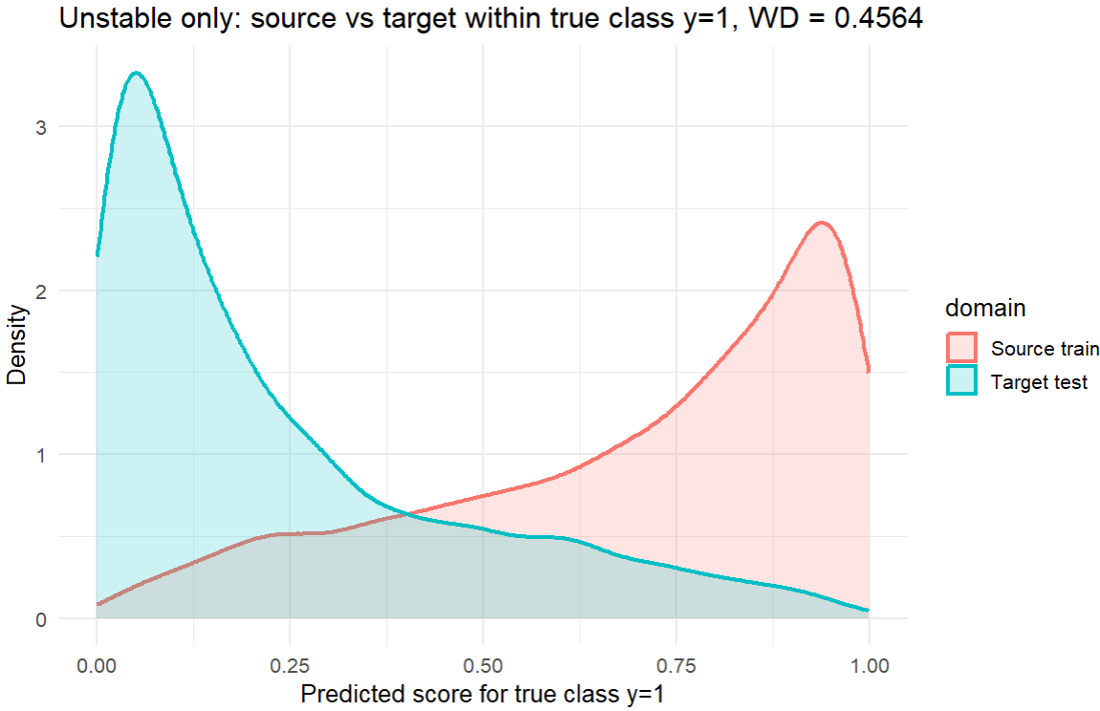
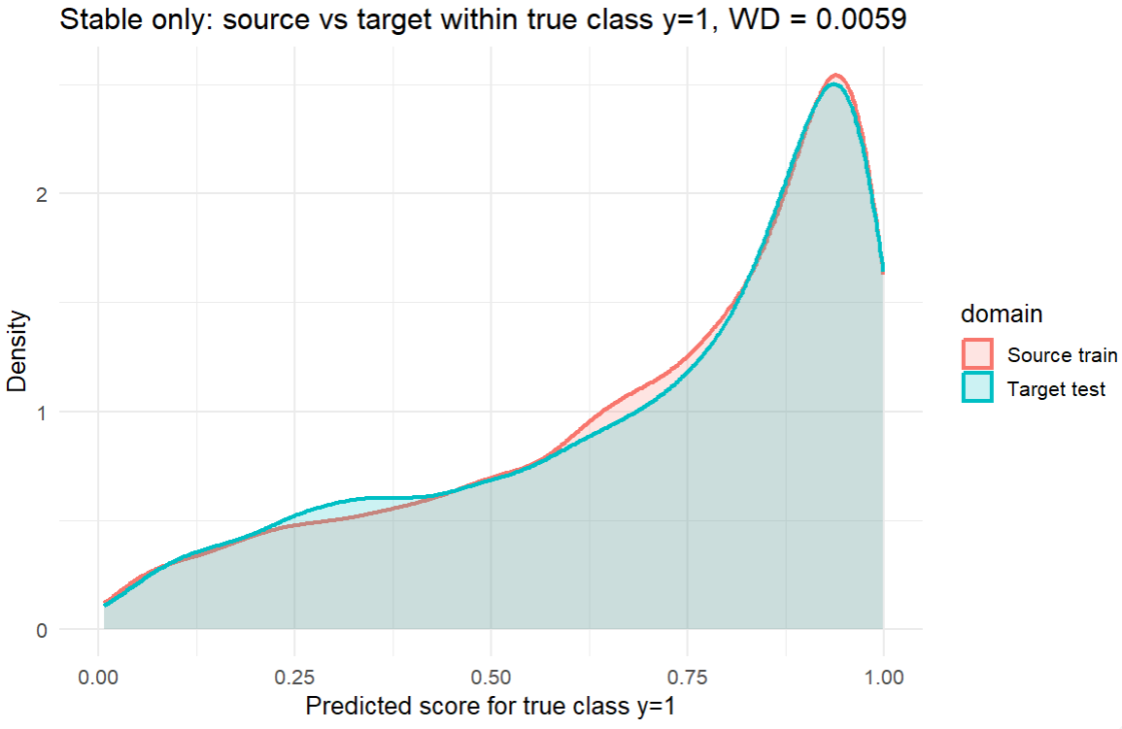
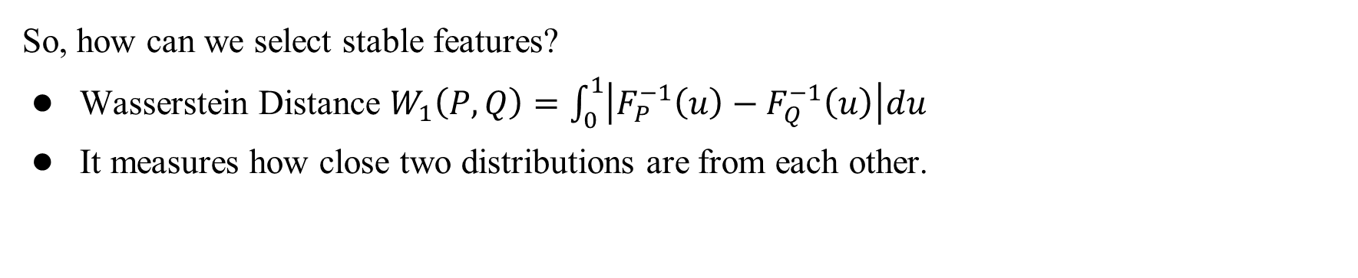
Variable Selection
So, how can we select stable features?
Wasserstein Distance $W_{1}\left(P,Q\right)=\int_{0}^{1}{\left|F_{P}^{−1}\left(u\right)−F_{Q}^{−1}\left(u\right)\right|du}$
It measures how close two distributions are from each other.
Notes:
Resampling process; extra slides for that. 1st one talk about measuring distance between distribution of predicted scores, with the definition of wassertein distance and how we can estimate it. Then the plots, the distance for stable and unstable features. Here we do not have true labels in real life, so how can we use the resampling procedures to do that? 2nd slide resampling process.

Slide 15
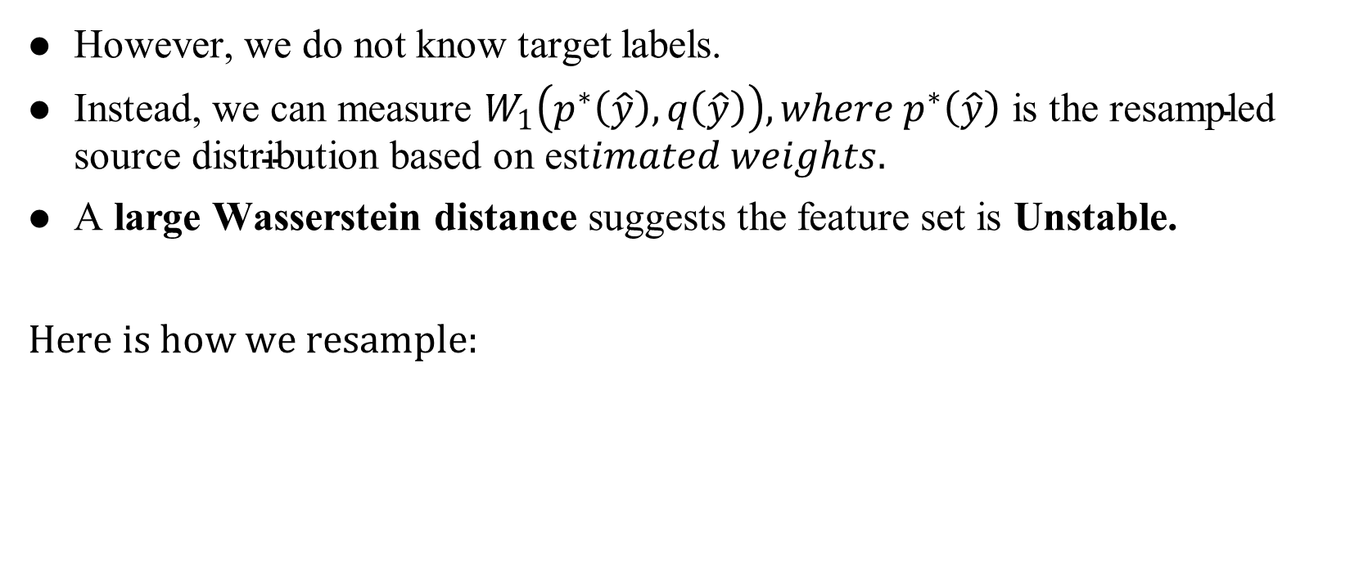
Resampling Procedure
However, we do not know target labels.
Instead, we can measure $W_{1}\left(p^{∗}\left(\hat{y}\right),q\left(\hat{y}\right)\right),where p^{∗}\left(\hat{y}\right) \text{is} \text{the} \text{resampled} \text{source} \text{distribution} \text{based} \text{on} \text{est}imated weights$.
A large Wasserstein distance suggests the feature set is Unstable.
Here is how we resample:
Train a classifier on the source data
Estimate weights using BBSE/MLLS
Resample the source data with replacement using estimated weights
Compute Wasserstein Distance $W_{1}\left(p^{∗}\left(\hat{y}\right),q\left(\hat{y}\right)\right)$
Compute Wasserstein Distance 𝑊_1 (𝑝^∗ (𝑦 ̂ ),𝑞(𝑦 ̂ ))

Slide 16

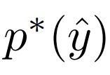

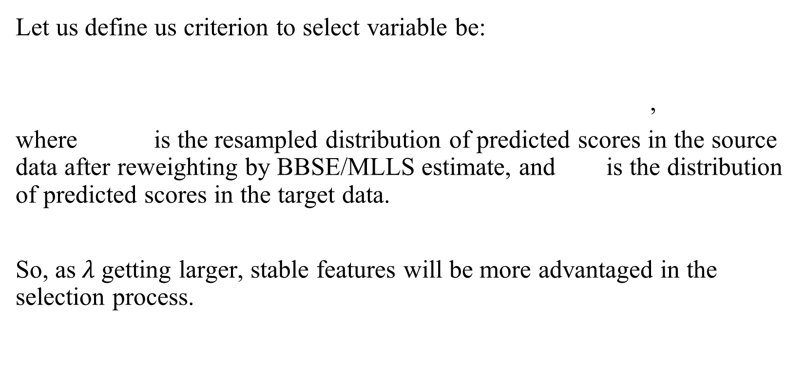
Criterion
Let us define us criterion to select variable be:
,
where is the resampled distribution of predicted scores in the source data after reweighting by BBSE/MLLS estimate, and is the distribution of predicted scores in the target data.
So, as$λ$ getting larger, stable features will be more advantaged in the selection process.

Slide 17
Simulation
In order to see which features will be selected, we simulated the following experiments:
Source data with n = 6000, Target data with n = 3000
p(y = 1) = 0.5 for source; q(y = 1) = 0.7 for target
Features are
Stable
Weakly unstable
Strongly unstable
Marginally stable, jointly unstable
Noise

Slide 18
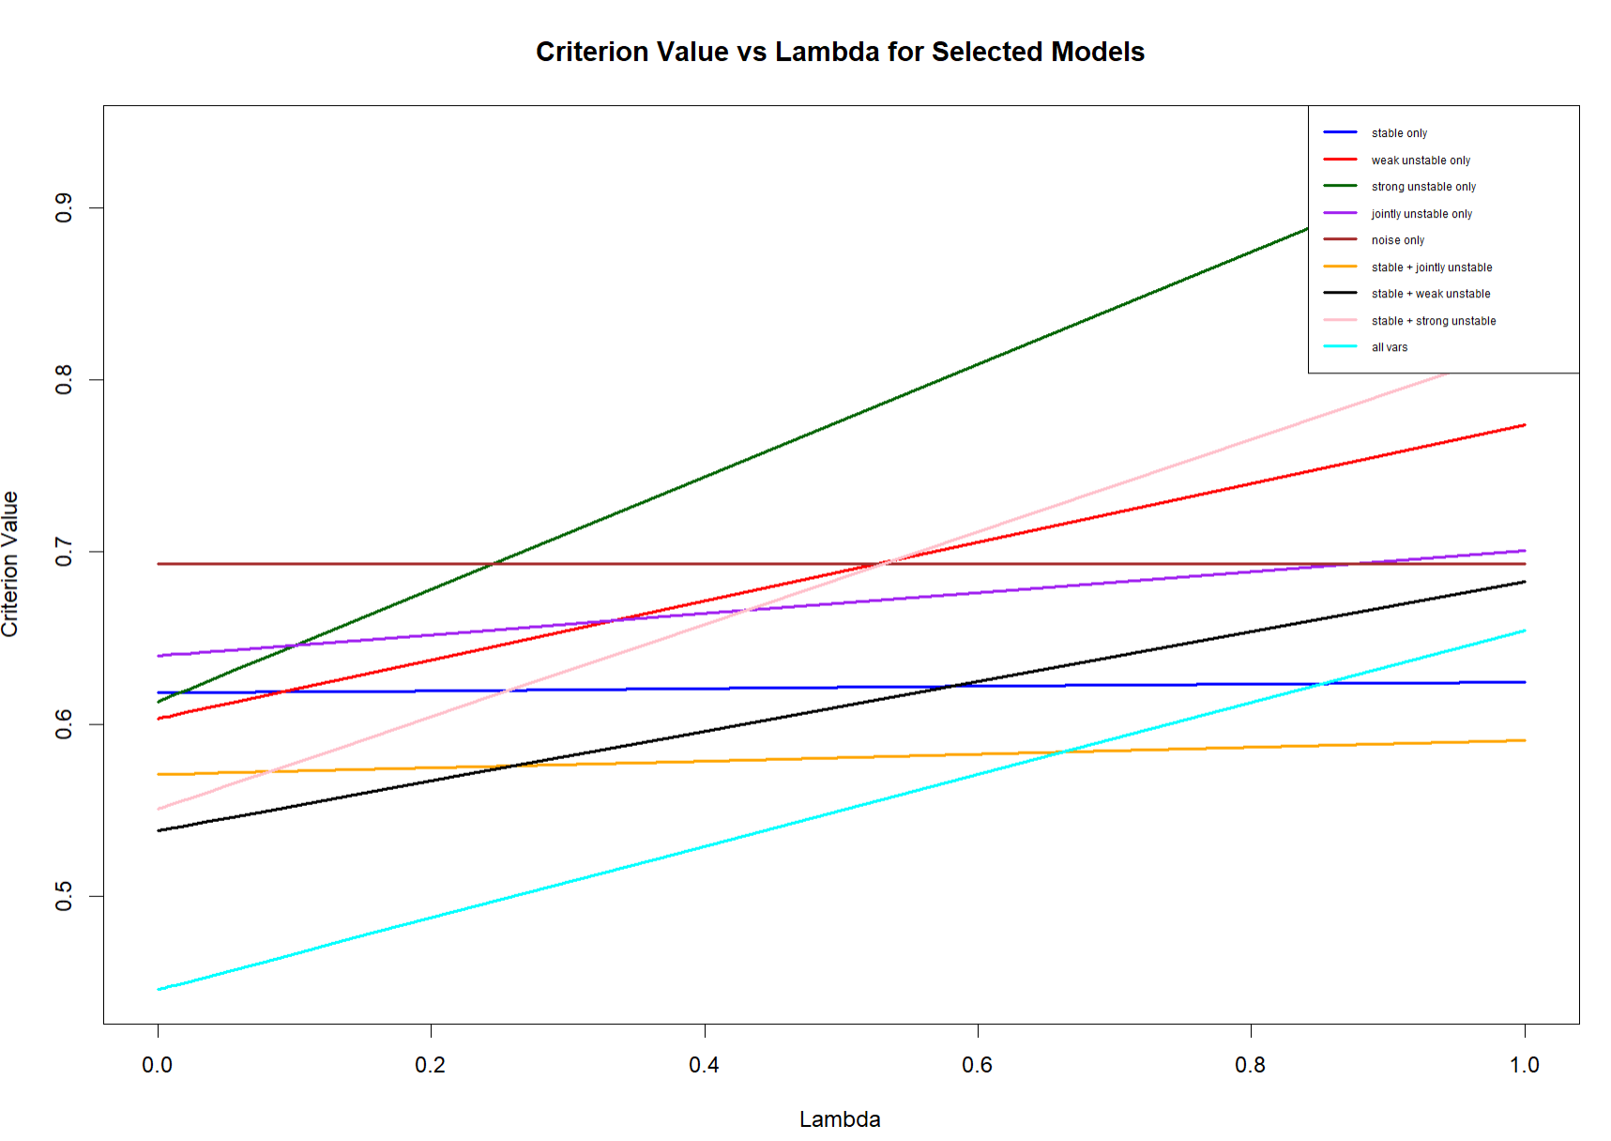
Variable Selection Result
Notes:
The NLL is on source.

Slide 19
Conclusion & Discussion
We can use BBSE/MLLS to improve the model as long as our features are stable.
MLLS is slightly better and more stable then BBSE.
Wasserstein Distance is a useful tool to detect stable features.
Unstable features are not 100% bad in terms of prediction, but enough stable features are needed for a well calibrated model.

Slide 20
Thank you
Notes:
Potential Questions
1. Why we measure the WD for the prediction not just the features
1 D easy, harder in muti dimension; we will miss the marginally stable ones
2. Why WD?
Easy on 1D; Used before in literature; Average instead of the worst case(KL Divergence)
3. Why use the line chart?
Better visualization
4. Why we care about calibration not predictions alone
We don’t know the true, so predictions

Slide 21

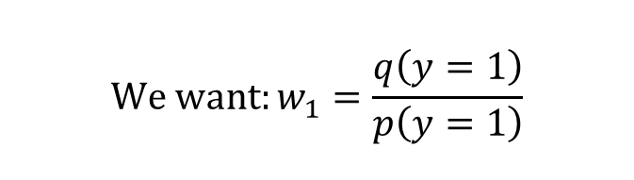
Black Box Shift Estimation (BBSE)
$$We want:w_{1}=\frac{q\left(y=1\right)}{p\left(y=1\right)}$$
$$q\left(\hat{y}=1\right)=q\left(\hat{y}=1,y=1\right)+q\left(\hat{y}=1,y=0\right)$$
$$=q\left(\hat{y}=1 ∣ y=1\right)q\left(y=1\right)+q\left(\hat{y}=1 ∣ y=0\right)q\left(y=0\right)$$
$$By Label Shift Assumption, we have q\left(\hat{y}=1 ∣ y=1\right)=p\left(\hat{y}=1 ∣ y=1\right), and$$
$$q\left(\hat{y}=1 ∣ y=0\right)=p\left(\hat{y}=1 ∣ y=0\right)$$
$$SO, q\left(\hat{y}=1\right)=p\left(\hat{y}=1 ∣ y=1\right)q\left(y=1\right)+p\left(\hat{y}=1 ∣ y=0\right)q\left(y=0\right)$$
$$=\frac{p\left(\hat{y}=1,y=1\right)}{p\left(y=1\right)}q\left(y=1\right)+\frac{p\left(\hat{y}=1,y=0\right)}{p\left(y=0\right)}q\left(y=0\right)$$
$$=p\left(\hat{y}=1,y=1\right)w_{1}+p\left(\hat{y}=1,y=0\right)w_{0}$$
$$Similarly,q\left(\hat{y}=0\right)=p\left(\hat{y}=0,y=1\right)w_{1}+p\left(\hat{y}=0,y=0\right)w_{0}$$
Notes:
focus on numerical examples

Slide 22
EM Algorithm & MLLS
Steps to use EM Algorithm
Train a probabilistic classifier on the source data and predict on the target data.
Initialize the target class proportions using the source class proportions.
compute soft labels for target observations.
update the target class proportions.
Repeat until convergence, then convert the result into label-shift weights.

Slide 23
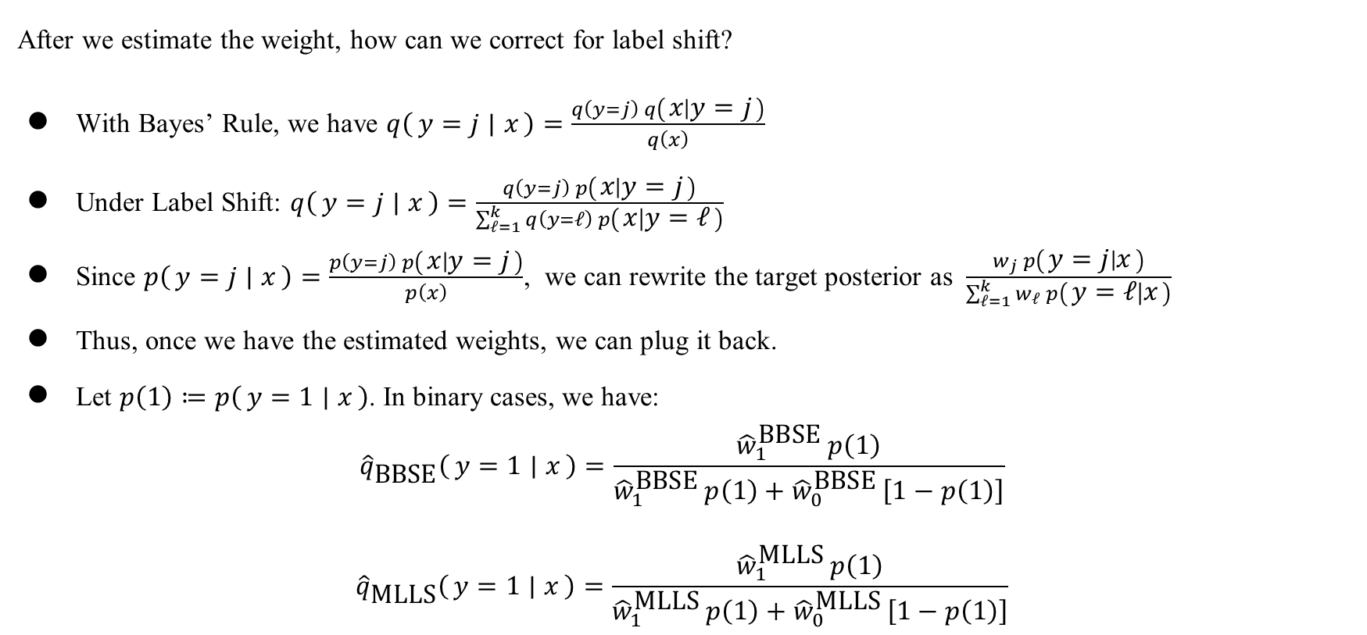
Label Shift Correction
After we estimate the weight, how can we correct for label shift?
With Bayes’ Rule, we have $q\left(y=j ∣ x\right)=\frac{q\left(y=j\right) q\left(x ∣ y=j\right)}{q\left(x\right)}$
Under Label Shift: $q\left(y=j ∣ x\right)=\frac{q\left(y=j\right) p\left(x ∣ y=j\right)}{\sum_{ℓ=1}^{k}{q\left(y=ℓ\right) p\left(x ∣ y=ℓ\right)}}$
Since $p\left(y=j ∣ x\right)=\frac{p\left(y=j\right) p\left(x ∣ y=j\right)}{p\left(x\right)}$, we can rewrite the target posterior as $\frac{w_{j} p\left(y=j ∣ x\right)}{\sum_{ℓ=1}^{k}{w_{ℓ} p\left(y=ℓ ∣ x\right)}}$
Thus, once we have the estimated weights, we can plug it back.
Let $p\left(1\right)≔p\left(y=1 ∣ x\right)$. In binary cases, we have:
$${\hat{q}}_{\text{BBSE}}\left(y=1 ∣ x\right)=\frac{{\hat{w}}_{1}^{\text{BBSE}} p\left(1\right)}{{\hat{w}}_{1}^{\text{BBSE}} p\left(1\right)+{\hat{w}}_{0}^{\text{BBSE}} \left[1−p\left(1\right)\right]}$$
$${\hat{q}}_{\text{MLLS}}\left(y=1 ∣ x\right)=\frac{{\hat{w}}_{1}^{\text{MLLS}} p\left(1\right)}{{\hat{w}}_{1}^{\text{MLLS}} p\left(1\right)+{\hat{w}}_{0}^{\text{MLLS}} \left[1−p\left(1\right)\right]}$$
Notes:
Bulletin by bulletin

